Slide 1
j.K.K.MUNIRAJAH COLLEGE OF TECNOLOGY
DEPARTMENT OF
ELECTRONICS AND COMMUNICATION ENGINEERING

Slide 2
IBM PROJECT
INTERNET OF THINGS
PHASE-III
TEAM LEADER
RANJITH.B
TEAM MEMBER
SANTHIYA.Y
VENEESWARI.M
SATHASIVAN.R
SAKTHISIVAN.K
SUBASH.K

Slide 3
INTRODUCTION :
Air is getting polluted because of release of toxic gases by industries, vehicle emissions and increased concentration of harmful gases and particulate matter in the atmosphere. The level of pollution is increasing rapidly due to factors like industries, urbanization, increasing in population, vehicle use which can affect human health.
Particulate matter is one of the most important parameter having the significant contribution to the increase in air pollution. This creates a need for measurement and analysis of real time air quality monitoring so that appropriate decisions can be taken in a timely period. This paper presents a real-time standalone air quality monitoring. Internet of Things is nowadays finding profound use in each and every sector, plays a key role in our air.

Slide 4
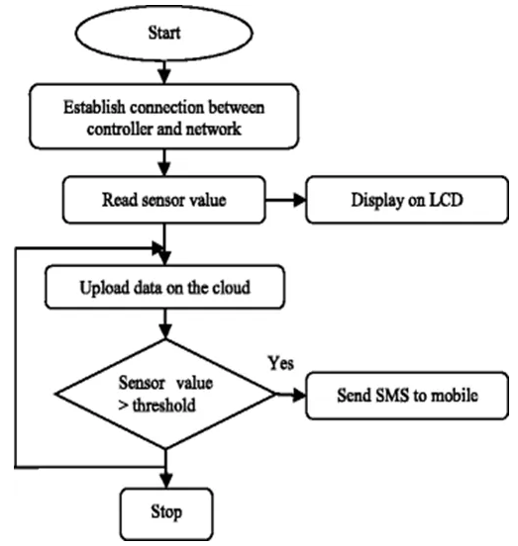
IOT Based Air Quality
Flow Chat

Slide 5
IOT Based Air Quality Monitoring System :
The level of pollution has increased with times by lot of factors like the increase in population, increased vehicle use, industrialization and urbanization which results in harmful effects on human wellbeing by directly affecting health of population exposed to it.
In order to monitor In this project we are going to make an IOT Based Air Pollution Monitoring System in which wet and will trigger a alarm when the air quality goes down beyond a certain level, means when there are sufficient amount of harmful gases are present in the air like CO2, smoke, alcohol, benzene and NH3. It will show the air quality in PPM on the LCD and as well as on webpage so that we can monitor it very easily. In this IOT project, you can monitor the pollution level from anywhere using your computer or mobile.

Slide 6
IOT Based Weather Monitoring System :
This Project makes use of 3 sensors to measure the weather/environment factors such as temperature, humidity, light intensity, dew point and heat index. The values read from the sensors are processed by the micro-controller and stored in a text file which can be processed upon to derive analysis. The readings are also displayed on an on board LCD for quick viewing. All these readings can be analyzed to get the weather characteristics of a particular area and record the weather pattern. These recorded parameters are essential and vary from places to places.

Slide 7
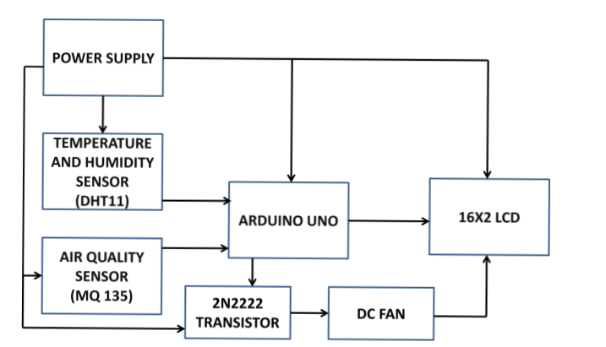
BLOCK DIAGRAM:

Slide 8
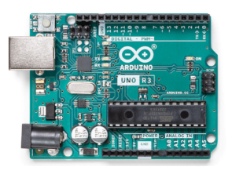
Components Required
Hardware Requirements
ARDUINO UNO :
ARDUINO Uno is a microcontroller from the ARDUINO Family. It was developed by ARDUINO. CC and is based on the Microchip ATmega328P microcontroller. Uno has 20 I/O pins, 6 are analog and 14 are digital pins.

Slide 9
DHT sensor:
DHT sensor is used to measure the temperature and humidity. It uses a capacitive humidity sensor to measure the surrounding air.
Gas sensor(MQ-135):
It is a low-cost application that is used for detecting smoke and toxic gases.
Red LED:
LED stands for the light-emitting diode. LED lighting products produce red light.
Green LED:
LED lighting products produce green light.
Buzzer:
An Audio Signaling Device. Buzzers can be mechanical, electromechanical, or piezoelectric. It produces an alarming sound when triggered. Used in various applications like Game buzzers, Alarm Buzzers, Trains, etc.
LCD:
LCD (Liquid Crystal Display) is a type of flat panel display used to print values.

Slide 10
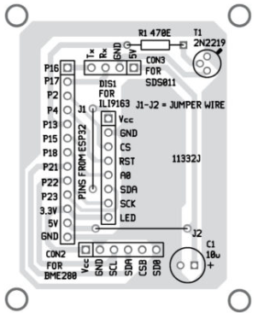
Software Requirements
ARDUINO IDE :
ARDUINO IDE (Integrated development environment) is software used to dump the program into boards. ARDUINO- IDE’s major use is to build electronics-related projects. ARDUINO is an open-source platform simple and easy-to-understand platform for coding.

Slide 11
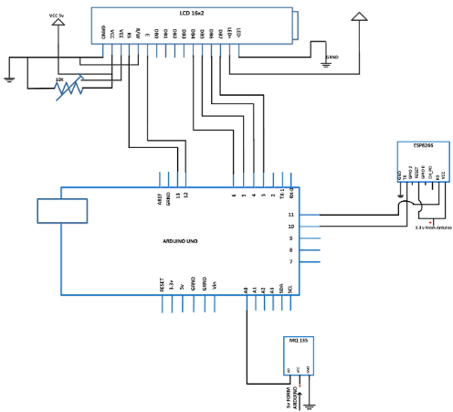
IOT Air Quality Monitoring

Slide 12
CODING:
#include "MQ135.h"
#include <SoftwareSerial.h>
#define DEBUG true
SoftwareSerial esp32(9,10);
const int sensorPin= 0;
int air_quality;
#include <LiquidCrystal.h>
LiquidCrystal lcd(12,11, 5, 4, 3, 2);
void setup() {

Slide 13
pinMode(8, OUTPUT);
lcd.begin(16,2);
lcd.setCursor (0,0);
lcd.print ("circuitdigest ");
lcd.setCursor (0,1);
lcd.print ("Sensor Warming ");
delay(1000);
Serial.begin(115200);
esp32.begin(115200);
sendData("AT+RST\r\n",2000,DEBUG);

Slide 14
sendData("AT+CWMODE=2\r\n",1000,DEBUG);
sendData("AT+CIFSR\r\n",1000,DEBUG);
sendData("AT+CIPMUair_quality=1\r\n",1000,DEBUG);
sendData("AT+CIPSERVER=1,80\r\n",1000,DEBUG);
pinMode(sensorPin, INPUT);
lcd.clear();
}
void loop() {
MQ135 gasSensor = MQ135(A0);
float air_quality = gasSensor.getPPM();

Slide 15
if(esp32.available())
{
if(esp32.find("+IPD,"))
{
delay(1000);
int connectionId = esp32.read()-48;
String webpage = "<h1>IOT Air Pollution Monitoring System</h1>";
webpage += "<p><h2>";
webpage+= " Air Quality is ";
webpage+= air_quality;
webpage+=" PPM";

Slide 16
webpage += "<p>";
if (air_quality<=1000)
{
webpage+= "Fresh Air";
}
else if(air_quality<=2000 && air_quality>=1000)
{
webpage+= "Poor Air";
}
else if (air_quality>=2000 )
{
webpage+= "Danger! Move to Fresh Air";
}

Slide 17
lcd.setCursor (0, 0);
lcd.print ("Air Quality is ");
lcd.print (air_quality);
lcd.print (" PPM ");
lcd.setCursor (0,1);
if (air_quality<=1000)
{
lcd.print("Fresh Air");
digitalWrite(8, LOW);
}
else if( air_quality>=1000 && air_quality<=2000 )

Slide 18
{
lcd.print("Poor Air, Open Windows");
digitalWrite(8, HIGH );
}
else if (air_quality>=2000 )
{
lcd.print("Danger! Move to Fresh Air");
digitalWrite(8, HIGH); // turn the LED on
}
lcd.scrollDisplayLeft();
delay(1000);
}

Slide 19
String sendData(String command, const int timeout, boolean debug)
{
String response = "";
esp32.print(command);
long int time = millis();
while( (time+timeout) > millis())
{
while(esp32.available())
{
// The esp has data so display its output to the serial window
char c = esp32.read(); // read the next character.
response+=c;
}

Slide 20
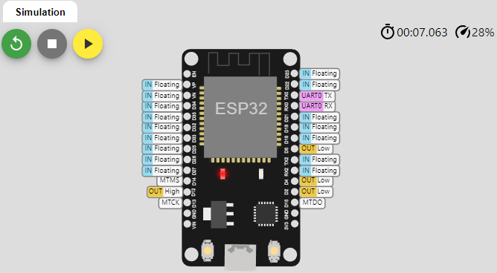
}
if(debug)
{
Serial.print(response);
}
return response;
}

Slide 21
OUTPUT:
ets Jul 29 2019 12:21:4
rst:0x1 (POWERON_RESET),boot:0x13 (SPI_FAST_FLASH_BOOT)
configsip: 0, SPIWP:0xee
clk_drv:0x00,q_drv:0x00,d_drv:0x00,cs0_drv:0x00,hd_drv:0x00,wp_drv:0x00
mode:DIO, clock div:2
load:0x3fff0030,len:1156
load:0x40078000,len:11456
ho 0 tail 12 room 4
load:0x40080400,len:2972
entry 0x400805dc

Slide 22
THANK YOU

